Slide 1
Chapter 5 End to End Protocols
Gandeva Bayu Satrya (GBS)
gbs@ittelkom.ac.id
gandeva.bayu.s@gmail.com
TELKOM ENGINEERING SCHOOL
Telkom University

Slide 2
Agenda
Chapter 5. End to End Protocols
E2E Protocols
Simple Demultiplexer (UDP)
Reliable Byte Stream (TCP)
RPC
RTP

Slide 3
Internet (TCP/IP) Protocol Suite
Application layer
DHCP DHCPv6 DNS FTP HTTP IMAP IRC LDAP MGCP NNTP BGP NTP POP RTP RTSP RIP SIP SMTP SNMP SOCKS SSH Telnet TLS/SSL XMPP more...
Transport layer
TCP UDP DCCP SCTP RSVP more...
Internet layer
IP IPv4 IPv6 OSPF ICMP ICMPv6 ECN IGMP IPsec more...
Network Access layer
ARP/InARP NDP Tunnels L2TP PPP Media access control Ethernet DSL ISDN FDDI DOCSIS more...

Slide 4
End to End Protocols
Common properties that a transport protocol can be expected to provide
Guarantees message delivery
Delivers messages in the same order they were sent
Delivers at most one copy of each message
Supports arbitrarily large messages
Supports synchronization between the sender and the receiver
Allows the receiver to apply flow control to the sender
Supports multiple application processes on each host

Slide 5
End to End Protocols
Typical limitations of the network on which transport protocol will operate
Drop messages
Reorder messages
Deliver duplicate copies of a given message
Limit messages to some finite size
Deliver messages after an arbitrarily long delay

Slide 6
End to End Protocols
Challenge for Transport Protocols
Develop algorithms that turn the less-than-desirable properties of the underlying network into the high level of service required by application programs
JMM Kamal, MS Hasan, AL Griffiths, H Yu
Development and verification of simulation model based on real MANET experiments for transport layer protocols (UDP and TCP)
International Journal of Automation and Computing. Springer.
February 2013, Volume 10, Issue 1, pp 53-63
Gurmeet Singh, and Jaswinder Singh
A review of TCP Reno, TCP Vegas and TFRC for mobile ad hoc networks.
2013 IJAIR. ALL RIGHTS RESERVED, Vol. 2 Issue 4 ISSN: 2278-7844.
Nuha, H.H. ; Hendrawan, H. ; Yulianto, F.A.
Wireless Multi-path TCP Westwood+ Modification to Achieve Fairness in HSDPA
Computer Modeling and Simulation (EMS), 2010 Fourth UKSim European Symposium on
Publication Year: 2010 , Page(s): 402-407 .

Slide 7
Agenda
Chapter 5. End to End Protocols
E2E Protocols
Simple Demultiplexer (UDP)
Reliable Byte Stream (TCP)
RPC
RTP

Slide 8
Simple Demultiplexer
A more common approach, and the one used by UDP, is for processes to indirectly identify each other using an abstract locater, usually called a port.
The basic idea is for a source process to send a message to a port and for the destination process to receive the message from a port.

Slide 9
User Datagram Protocol (UDP)
Extends host-to-host delivery service of the underlying network into a process-to-process communication service
Adds a level of demultiplexing which allows multiple application processes on each host to share the network
Connectionless
There is no ﬂow-control mechanism in UDP to tell the sender to slowdown.
UDP does not implement ﬂow control or reliable/ordered delivery

Slide 10
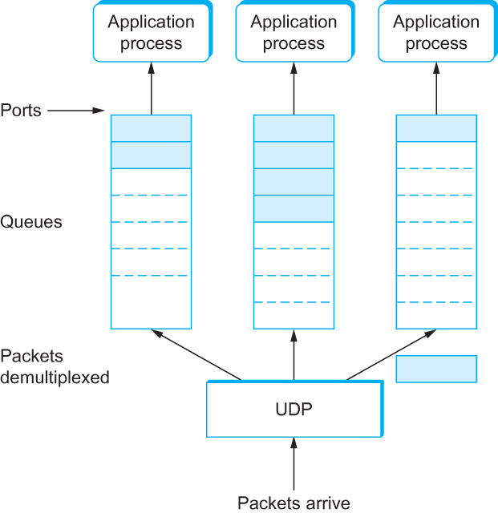
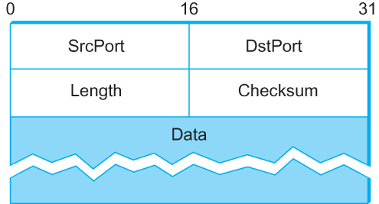
UDP Header
UDP Header UDP Message Queue

Slide 11
Agenda
Chapter 5. End to End Protocols
E2E Protocols
Simple Demultiplexer (UDP)
Reliable Byte Stream (TCP)
RPC
RTP

Slide 12
Reliable Byte Stream
In contrast to UDP, Transmission Control Protocol (TCP) offers the following services
Reliable
Sequence and Acknowledgement
Connection oriented
Byte-stream service

Slide 13
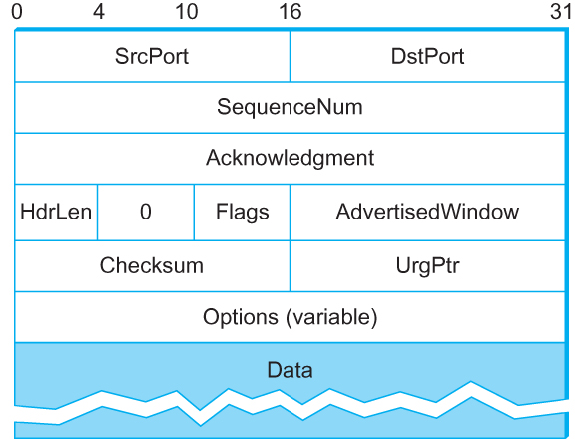
Transmission Control Protocol (TCP)

Slide 14
Flow Control VS Congestion Control
Flow control involves preventing senders from overrunning the capacity of the receivers
Congestion control involves preventing too much data from being injected into the network, thereby causing switches or links to become overloaded

Slide 15
TCP
As TCP runs over the Internet rather than a point-to-point link, the following issues need to be addressed by the Sliding Window Algorithm
TCP supports logical connections between processes that are running on two different computers in the Internet
TCP connections are likely to have widely different RTT times
Packets may get reordered in the Internet
TCP needs a mechanism using which each side of a connection will learn what resources the other side is able to apply to the connection
TCP needs a mechanism using which the sending side will learn the capacity of the network
Notes:
At the heart of TCP is the sliding window algorithm (discussed in Chapter 2)

Slide 16
TCP Segment (process)
TCP is a byte-oriented protocol, which means that the sender writes bytes into a TCP connection and the receiver reads bytes out of the TCP connection.
Although “byte stream” describes the service TCP offers to application processes, TCP does not, itself, transmit individual bytes over the Internet.

Slide 17
TCP Segment (process)
TCP on the source host buffers enough bytes from the sending process to fill a reasonably sized packet and then sends this packet to its peer on the destination host.
TCP on the destination host then empties the contents of the packet into a receive buffer, and the receiving process reads from this buffer at its leisure.
The packets exchanged between TCP peers are called segments.

Slide 18
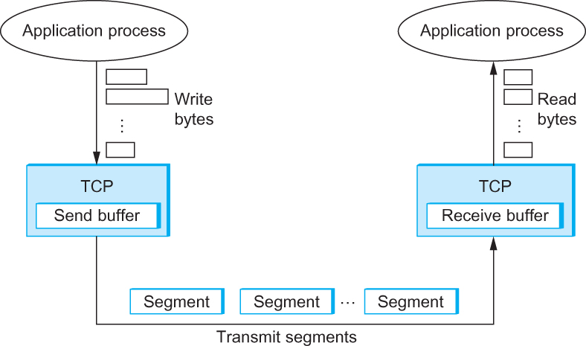
TCP Segment
How TCP manages a byte stream.

Slide 19
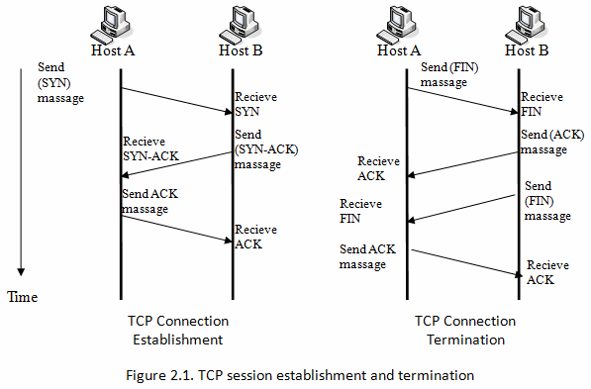
Establishment & Termination

Slide 20
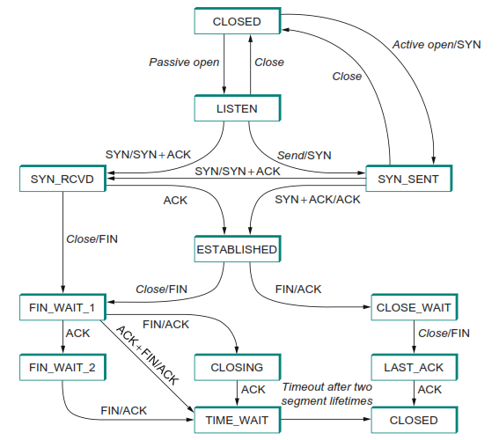
TCP state-transition diagram

Slide 21
Sliding Window Revisited
TCP’s variant of the sliding window algorithm, which serves several purposes:
(1) it guarantees the reliable delivery of data,
(2) it ensures that data is delivered in order, and
(3) it enforces flow control between the sender and the receiver.

Slide 22
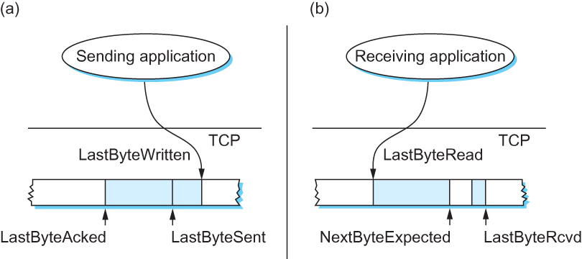
Sliding Window Revisited
Sending Side LastByteAcked ≤ LastByteSent LastByteSent ≤ LastByteWritten | Receiving Side LastByteRead < NextByteExpected NextByteExpected ≤ LastByteRcvd + 1

Slide 23
TCP Flow Control
LastByteRcvd − LastByteRead ≤ MaxRcvBuffer
AdvertisedWindow = MaxRcvBuffer − ((NextByteExpected − 1) − LastByteRead)
LastByteSent − LastByteAcked ≤ AdvertisedWindow
EffectiveWindow = AdvertisedWindow − (LastByteSent − LastByteAcked)
LastByteWritten − LastByteAcked ≤ MaxSendBuffer
If the sending process tries to write y bytes to TCP, but
(LastByteWritten − LastByteAcked) + y > MaxSendBuffer
then TCP blocks the sending process and does not allow it to generate more data.

Slide 24
Protecting against Wraparound
SequenceNum: 32 bits longs
AdvertisedWindow: 16 bits long
TCP has satisfied the requirement of the sliding
window algorithm that is the sequence number
space be twice as big as the window size (2³² >> 2 × 2¹⁶)
Packets cannot survive in the Internet for longer than the MSL
MSL is set to 120 sec
We need to make sure that the sequence number does not wrap around within a 120-second period of time
Depends on how fast data can be transmitted over the Internet
Notes:
Maximum Segment Lifetime

Slide 25
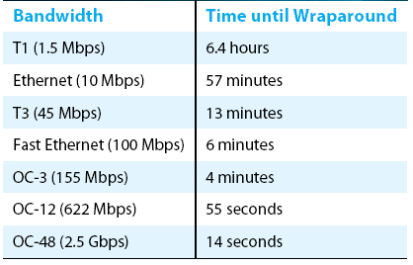
Protecting against Wraparound
Notes:
Maximum Segment Lifetime

Slide 26
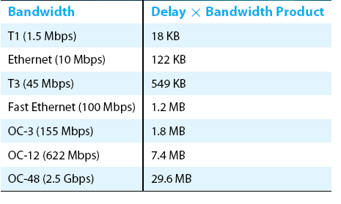
Keeping the Pipe Full
If the receiver has enough buffer space
The window needs to be opened far enough to allow a full
delay × bandwidth product’s worth of data
Assuming an RTT of 100 ms
Notes:
Maximum Segment Lifetime

Slide 27
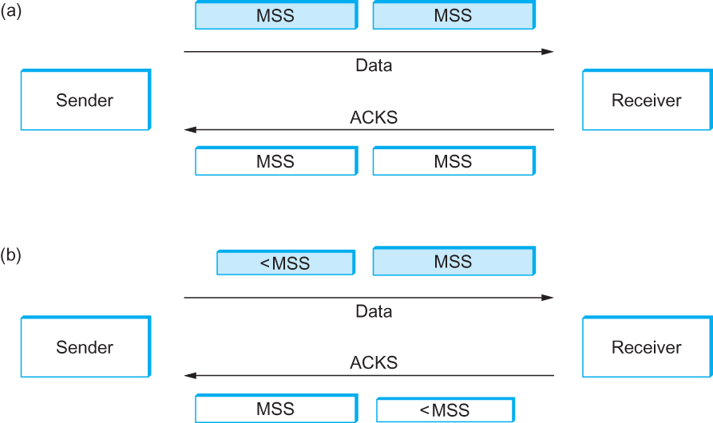
Silly Window Syndrome

Slide 28
Nagle’s Algorithm
If there is data to send but the window is open less than MSS, then we may want to wait some amount of time before sending the available data
But how long?
If we wait too long, then we hurt interactive applications like Telnet
If we don’t wait long enough, then we risk sending a bunch of tiny packets and falling into the silly window syndrome
The solution is to introduce a timer and to transmit when the timer expires

Slide 29
Nagle’s Algorithm
We could use a clock-based timer, for example one that fires every 100 ms
Nagle introduced an elegant self-clocking solution
Key Idea
As long as TCP has any data in flight, the sender will eventually receive an ACK
This ACK can be treated like a timer firing, triggering the transmission of more data

Slide 30
Nagle’s Algorithm
When the application produces data to send
if both the available data and the window ≥ MSS send a full segment else if there is unACKed data in flight buffer the new data until an ACK arrives else send all the new data now

Slide 31
Original Algorithm
Problem
ACK does not really acknowledge a transmission
It actually acknowledges the receipt of data
When a segment is retransmitted and then an ACK arrives at the sender
It is impossible to decide if this ACK should be associated with the first or the second transmission for calculating RTTs

Slide 32
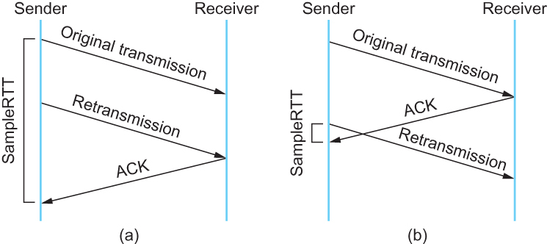
Karn/Partridge Algorithm
Associating the ACK with (a) original transmission versus (b) retransmission

Slide 33
Karn/Partridge Algorithm
Do not sample RTT when retransmitting
Double timeout after each retransmission

Slide 34
Karn/Partridge Algorithm
Karn-Partridge algorithm was an improvement over the original approach, but it does not eliminate congestion
We need to understand how timeout is related to congestion
If you timeout too soon, you may unnecessarily retransmit a segment which adds load to the network

Slide 35
Karn/Partridge Algorithm
Main problem with the original computation is that it does not take variance of Sample RTTs into consideration.
If the variance among Sample RTTs is small
Then the Estimated RTT can be better trusted
There is no need to multiply this by 2 to compute the timeout

Slide 36
Karn/Partridge Algorithm
On the other hand, a large variance in the samples suggest that timeout value should not be tightly coupled to the Estimated RTT
Jacobson/Karels proposed a new scheme for TCP retransmission

Slide 37
Jacobson/Karels Algorithm
Difference = SampleRTT − EstimatedRTT
EstimatedRTT = EstimatedRTT + (δ × Difference)
Deviation = Deviation + δ (|Difference| − Deviation)
Where δ is a fraction between 0 and 1
TimeOut = μ × EstimatedRTT + φ × Deviation
where based on experience, μ is typically set to 1 and φ is set to 4. Thus, when the variance is small, TimeOut is close to EstimatedRTT; a large variance causes the deviation term to dominate the calculation.

Slide 38
Agenda
Chapter 5. End to End Protocols
E2E Protocols
Simple Demultiplexer (UDP)
Reliable Byte Stream (TCP)
RPC
RTP

Slide 39
Remote Procedure Call
In Computer Science, a Remote Procedure Call (RPC) is an inter-process communication that allows a computer program to cause a subroutine or procedure to execute in another address space (commonly on another computer on a shared network) without the programmer explicitly coding the details for this remote interaction.
Wikipedia, Nov 2013.
Remote Procedure Call (RPC), that more closely matches the needs of an application involved in a request/reply message exchange.
Peterson 2012

Slide 40
Remote Procedure Call
When the procedures being called are actually methods of remote objects in an Object-oriented Language.
RPC is known as Remote Method Invocation (RMI)
While the RPC concept is simple, there are two main problems that make it more complicated than local procedure calls:
The network between the calling process and the called process has much more complex properties than the backplane of a computer. For example, it is likely to limit message sizes and has a tendency to lose and reorder messages.
The computers on which the calling and called processes run may have signiﬁcantly different architectures and data representation formats.

Slide 41
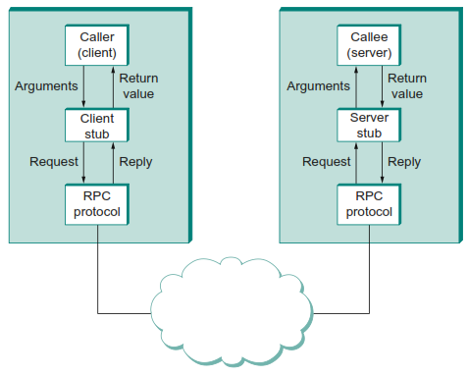
RPC Mechanism
We focus on “RPC Protocol (stack)”
fragments and reassembles large messages (by BLAST)
synchronizes request and reply messages (by CHAN)
dispatches request to the correct process/procedure (by SELECT)

Slide 42
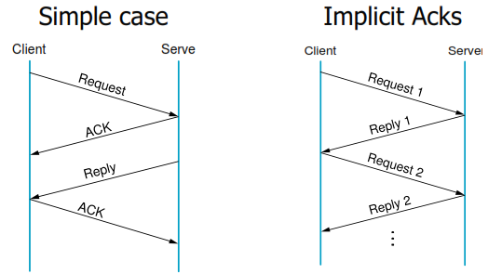
Request n Reply in RPC

Slide 43

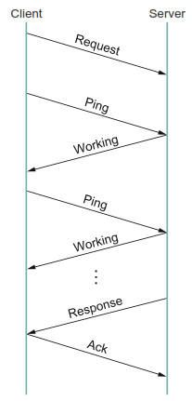

RPC Implementation
SIMPLE RPC SunRPC DCE-RPC

Slide 44
Agenda
Chapter 5. End to End Protocols
E2E Protocols
Simple Demultiplexer (UDP)
Reliable Byte Stream (TCP)
RPC
RTP

Slide 45
Why RTP
Real-time traffic: digitized voice, video, etc.
Experiments with real-time traffic since 1981
Why not existing transport protocols?
UDP: best effort, no guarantee on delay and delay jitter
TCP: long delay and large delay jitter due to retransmission
RPC: designed for interactive exchange of (mostly short) messages

Slide 46
Requirements for RTP
To be generic and to support different applications (e.g., w/ diff. encoding schemes)
To identify timing relationship among received data;
To synchronize related media streams (e.g., audio & video data streams)
To detect and report packet loss (even though no need for 100% reliability)

Slide 47
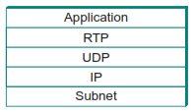
Requirements for RTP
Runs over UDP
Application-Level Framing
leave application specific details to applications through “profile” and “formats”
Profile: specifies how to interpret the RTP header information
Format: specifies how to interpret the data following the RTP header
1) Data packets: specified by RTP
2) Periodic control packets: specified by RTCP (Real-time Transport Control Protocol)

Slide 48
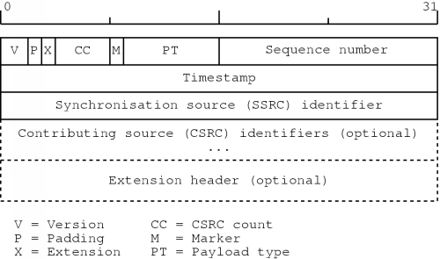
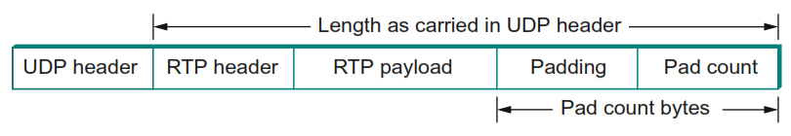
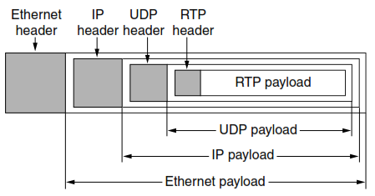
RTP Header Format

Slide 49
Bibliography
Kurose, J.F., and Ross, K.W., Computer Networking : A Top-Down Approach Sixth Edition, Pearson Education, Inc. USA, 2013.
Lammle T., Cisco Certified Network Associate : Study Guide Fifth Edition, Sybex, Inc. USA, 2005.
Peterson, L.L., and Davie, B.S., Computer Networks: A Systems Approach Fifth Edition, Morgan Kaufmann, Burlington USA, 2012.
Tanenbaum, A.S., and Wetherall, D.J., Computer Networks Fifth Edition, Pearson Education, Inc., Boston USA, 2011.

Slide 50
THANK YOU
Gandeva Bayu Satrya (GBS)
gbs@ittelkom.ac.id
gandeva.bayu.s@gmail.com
TELKOM ENGINEERING SCHOOL
Telkom University

